Slide 1
PROJECT- INCOME QUALIFICATION
Submitted by: Mr. Tejas Phase

Slide 2
KINDLY NOTE: THE MODEL BUILDING IS DIVIDED INTO 2 PARTS:
MODEL BUILDING WITHOUT FEATURE ENGINNERING(FETURE REDUCTION)
MODEL BUILDING WITH FEATURE ENGINNERING(USING PCA)

Slide 3
PART-1:MODEL BUILDING WITHOUT FEATURE ENGINNERING

Slide 4
PREPROCESSING ON TRAINING DATASET

Slide 5
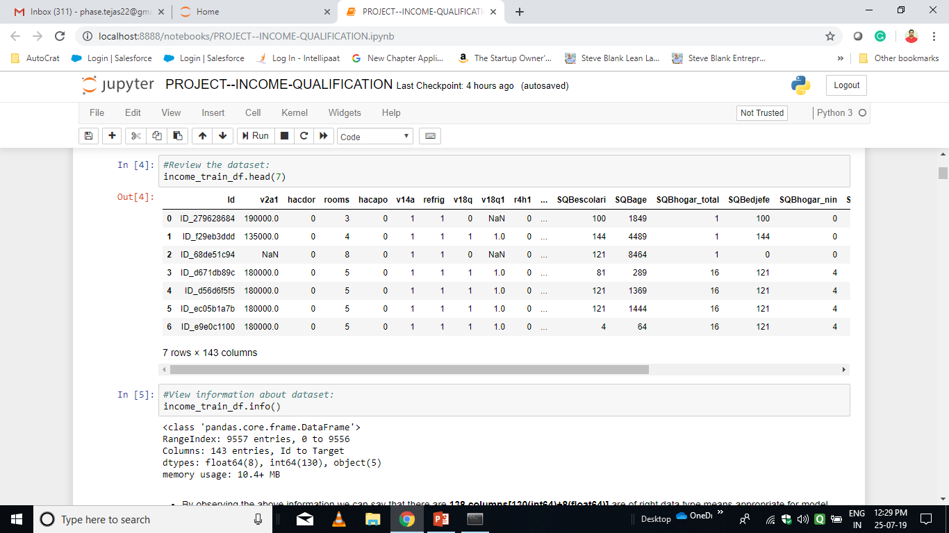
After loading training dataset, first 5 records of the dataframe:

Slide 6
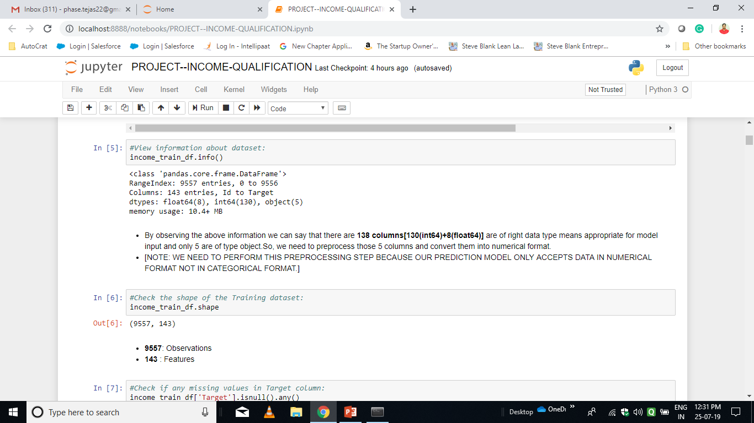
The information about the entire dataset and shape of it:

Slide 7
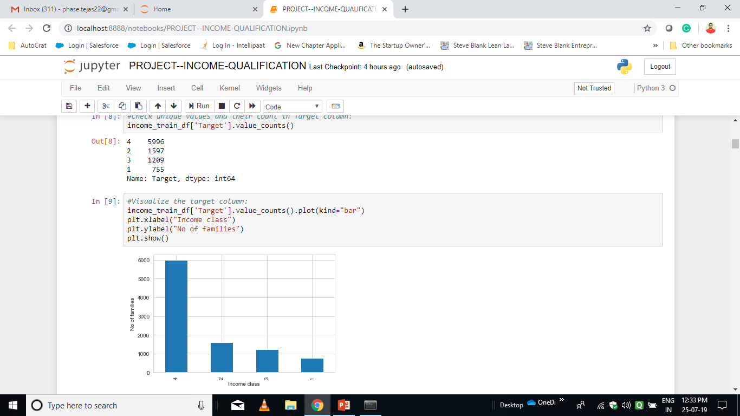
Analysis of Target Variable:

Slide 8
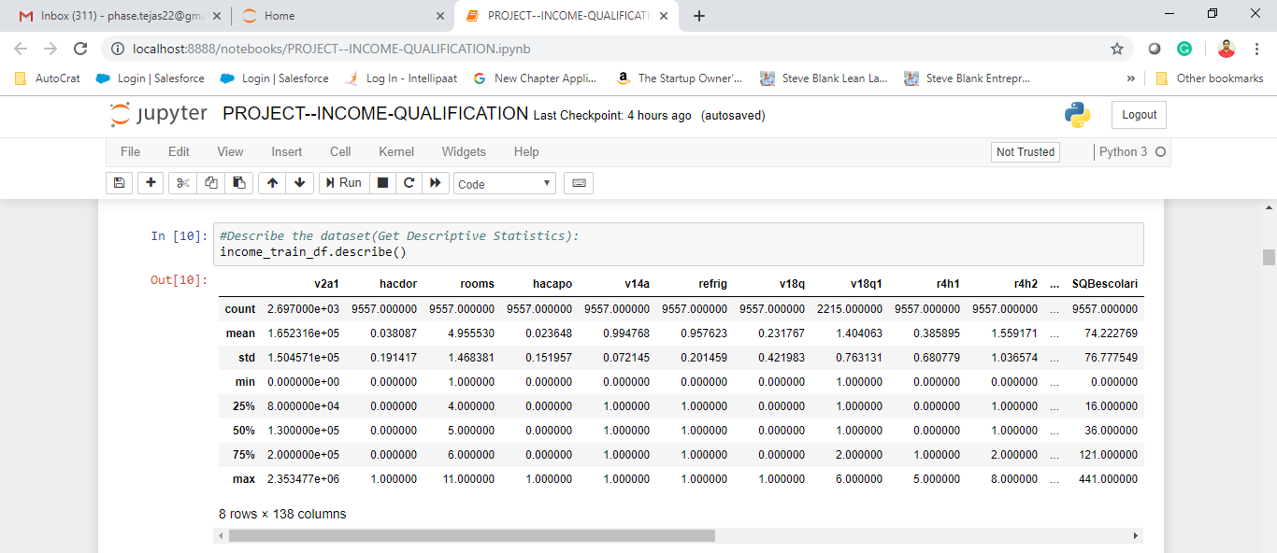
Descriptive Statistics of the dataset:

Slide 9
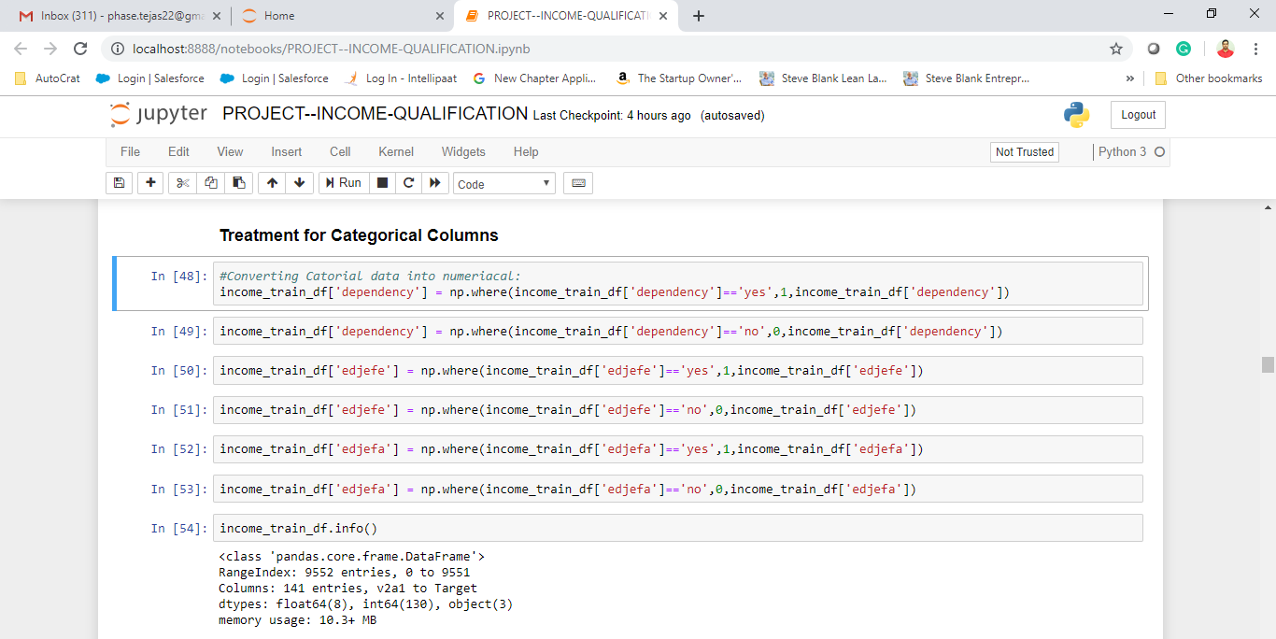
Treatment for Categorical Columns:

Slide 10
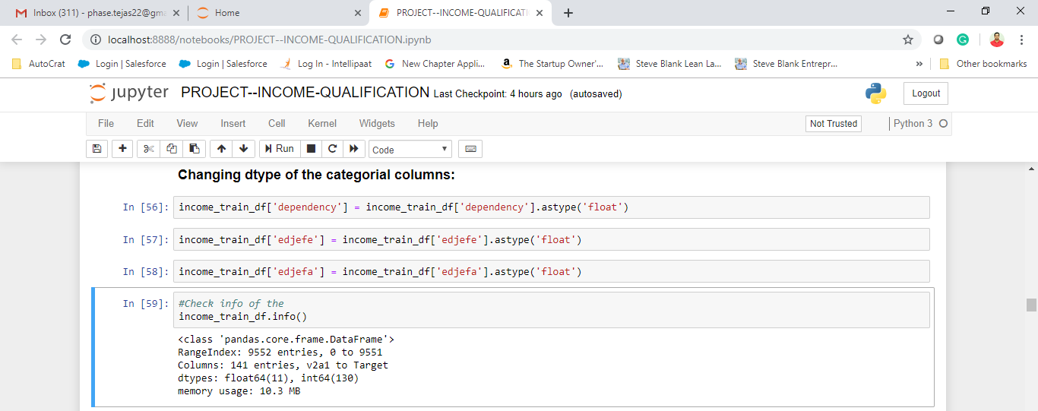
Changing dtype of the categorical columns:

Slide 11
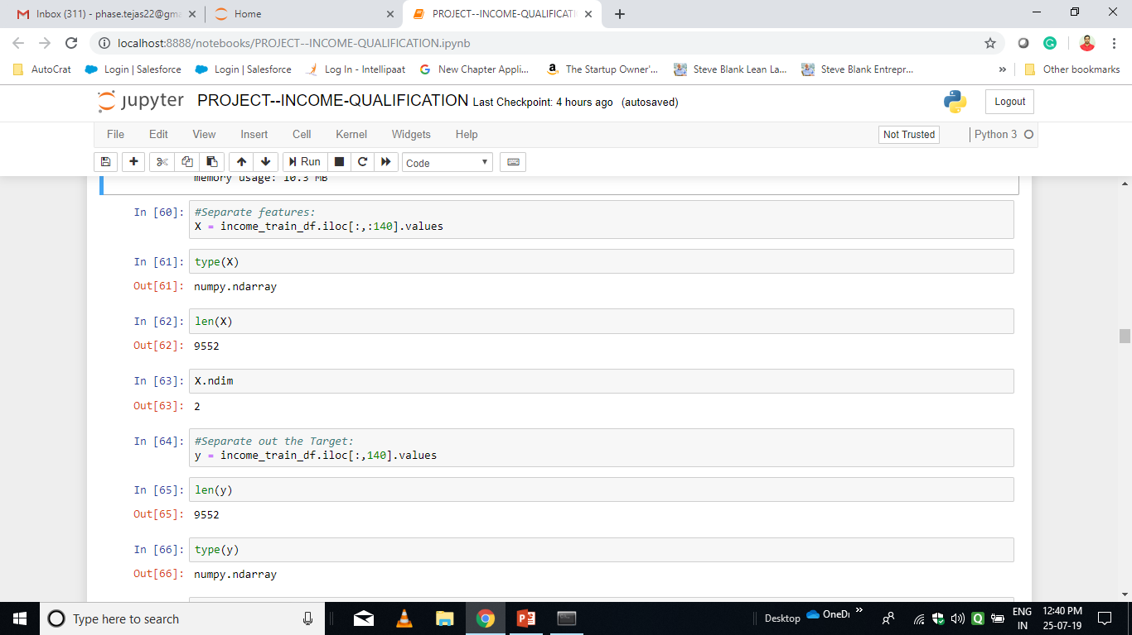
Separate features and columns:

Slide 12
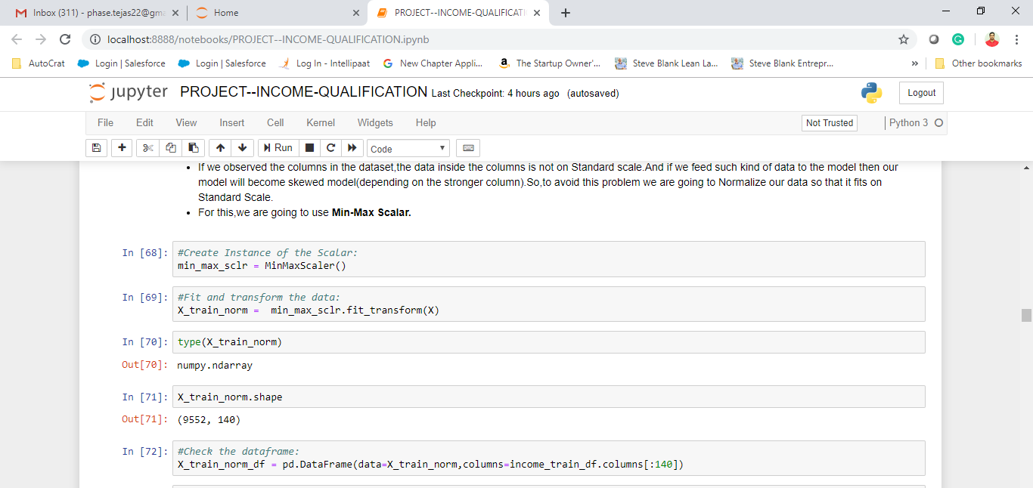
Normalize the dataset:

Slide 13
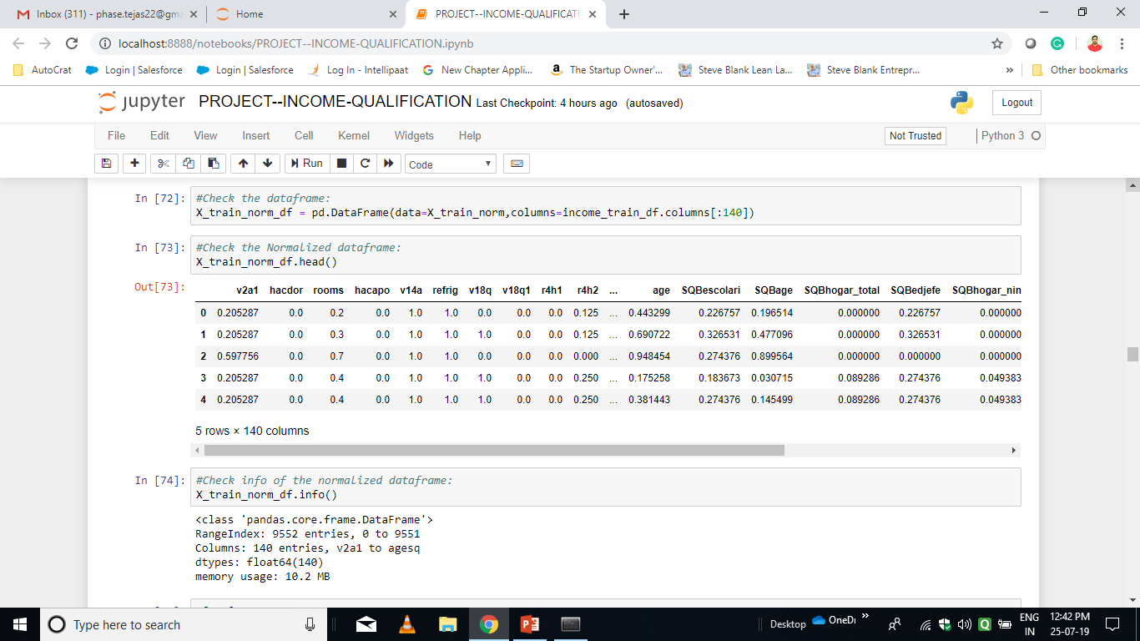
Normalized Dataframe:

Slide 14
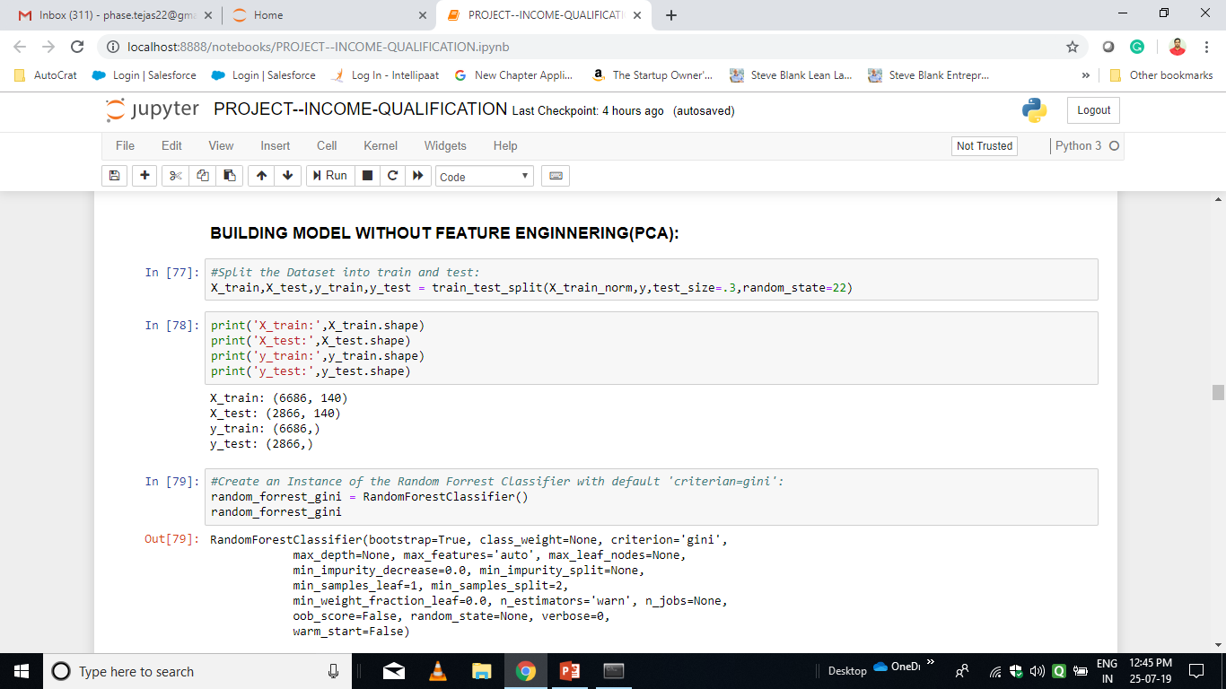
#Building Model without feature engineering: Train-Test Split and Model Class Instantiation:

Slide 15
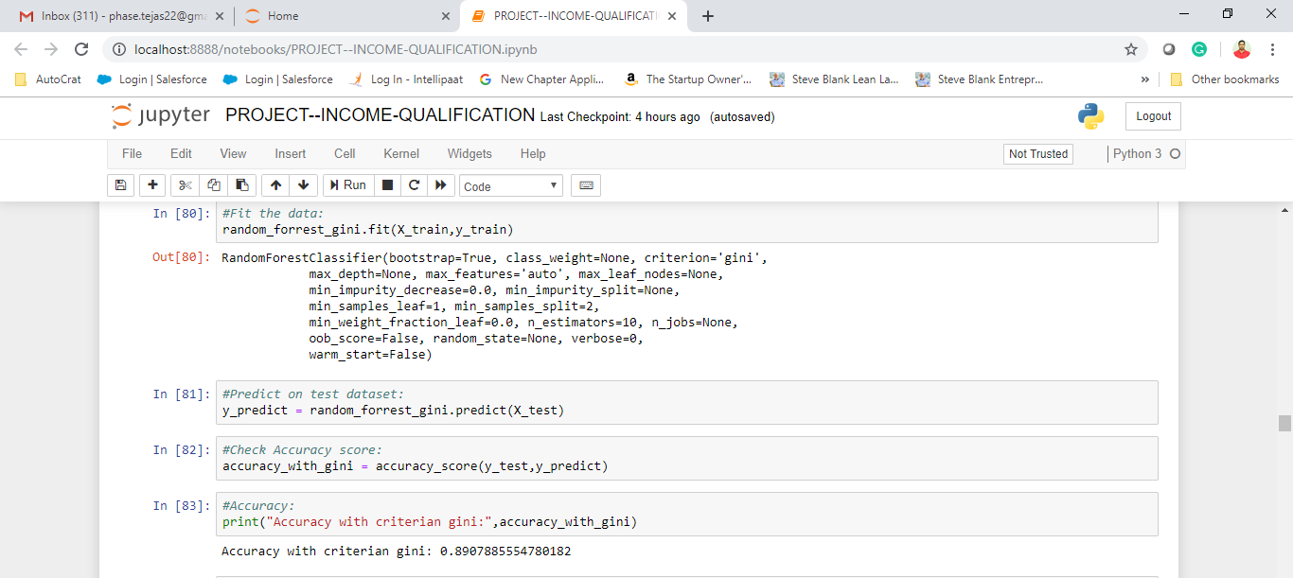
Fit the Data and getting prediction and check Accuracy:

Slide 16
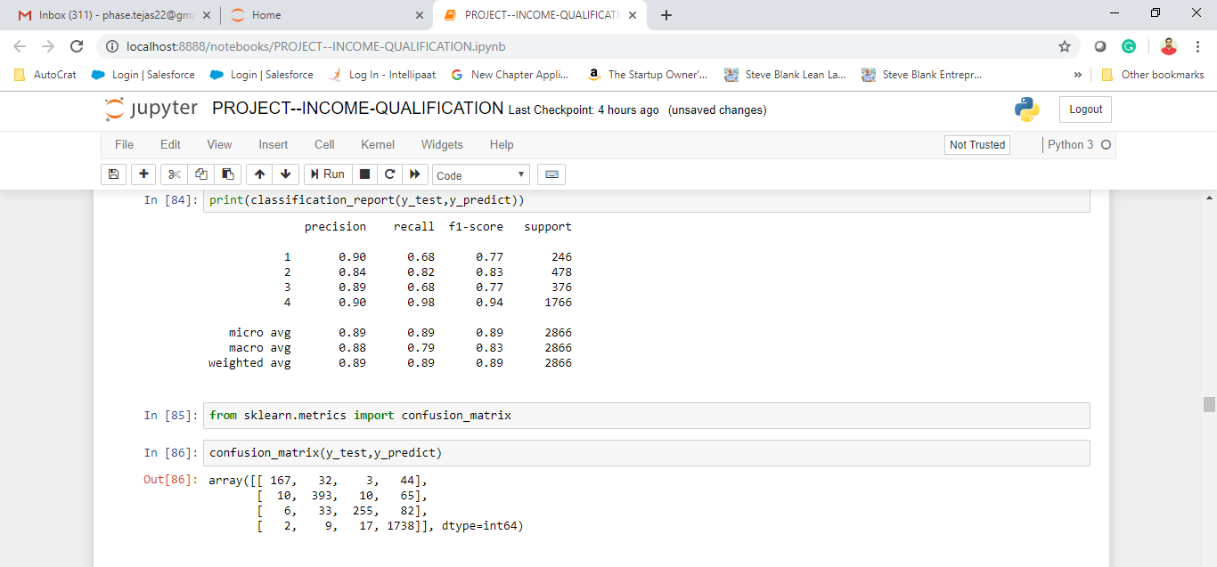
Print classification report and confusion matrix for Multi-classification:

Slide 17
PREPROCESSING ON TEST DATASET

Slide 18
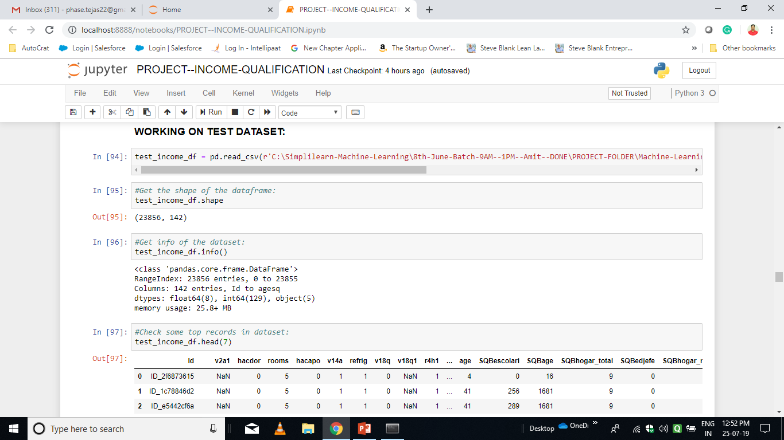
Dataset loading, observing shape and checking first 5 records:

Slide 19
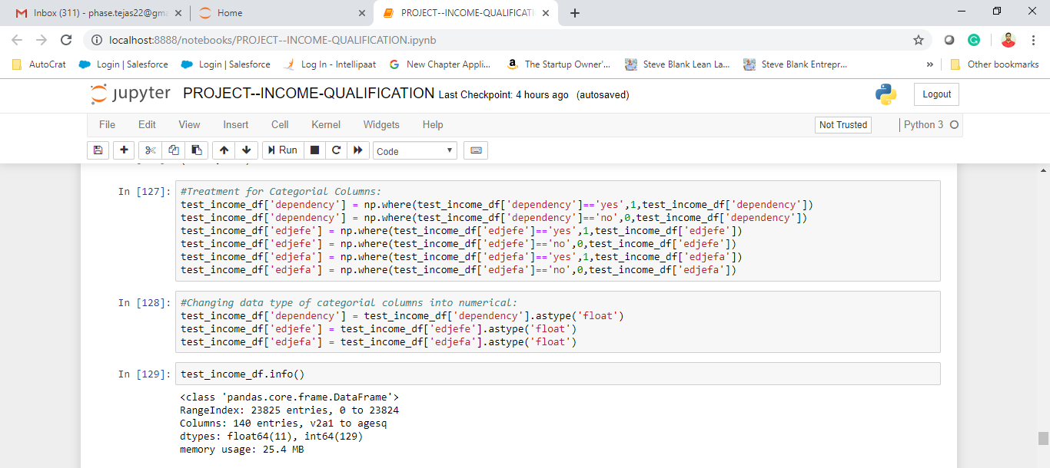
Treatment for Categorical Columns:

Slide 20
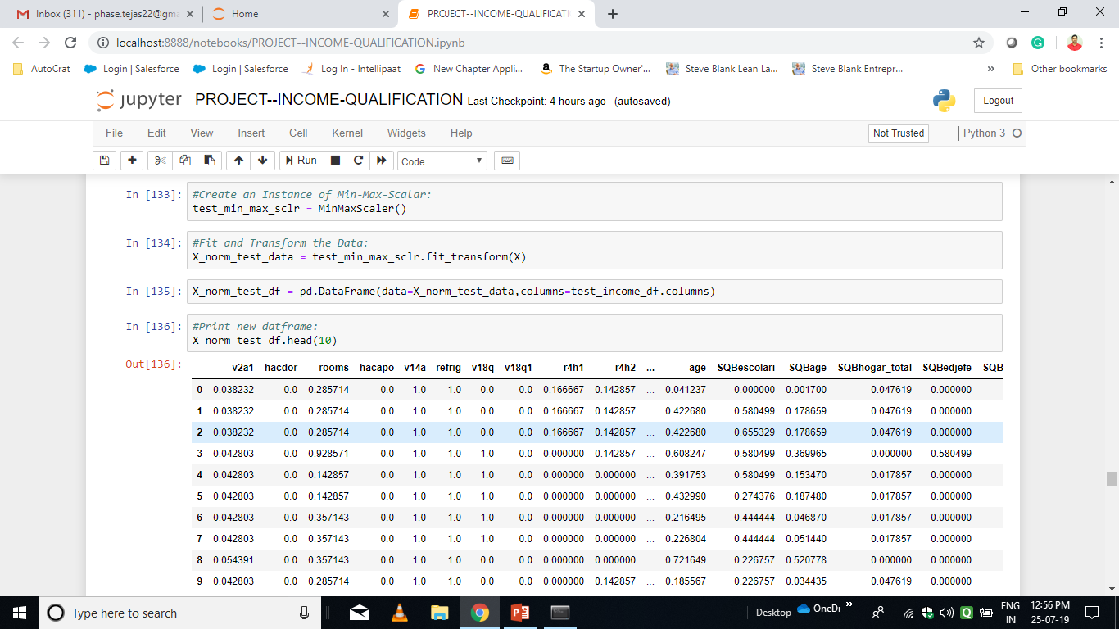
Normalized the dataset:

Slide 21
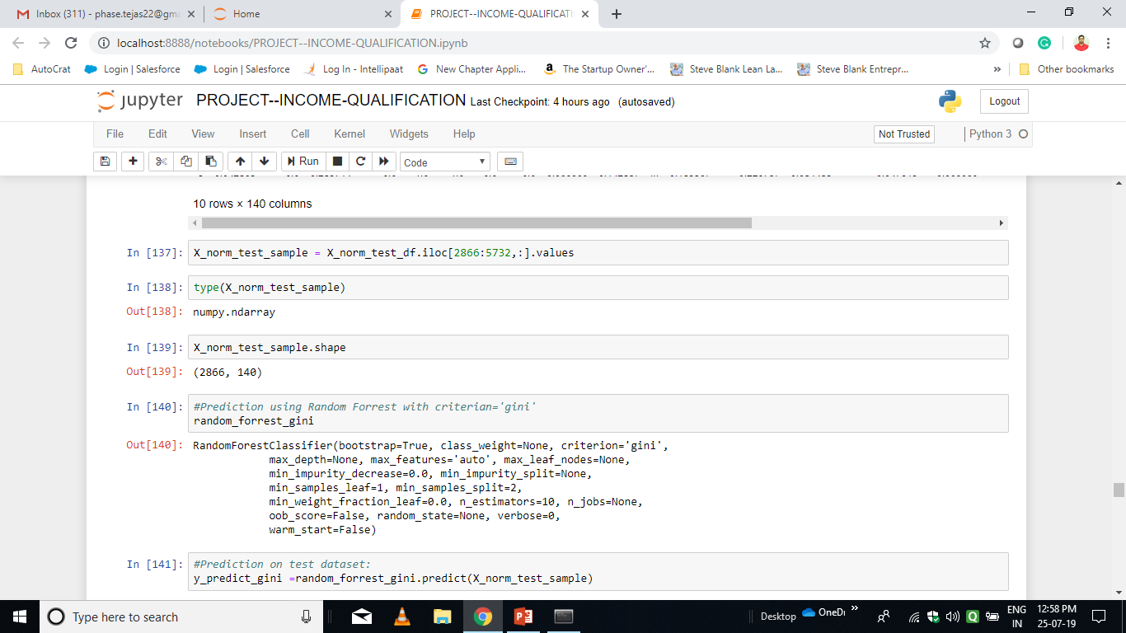
Getting sub-sample from the dataset and predict Target values using Trained Model:

Slide 22
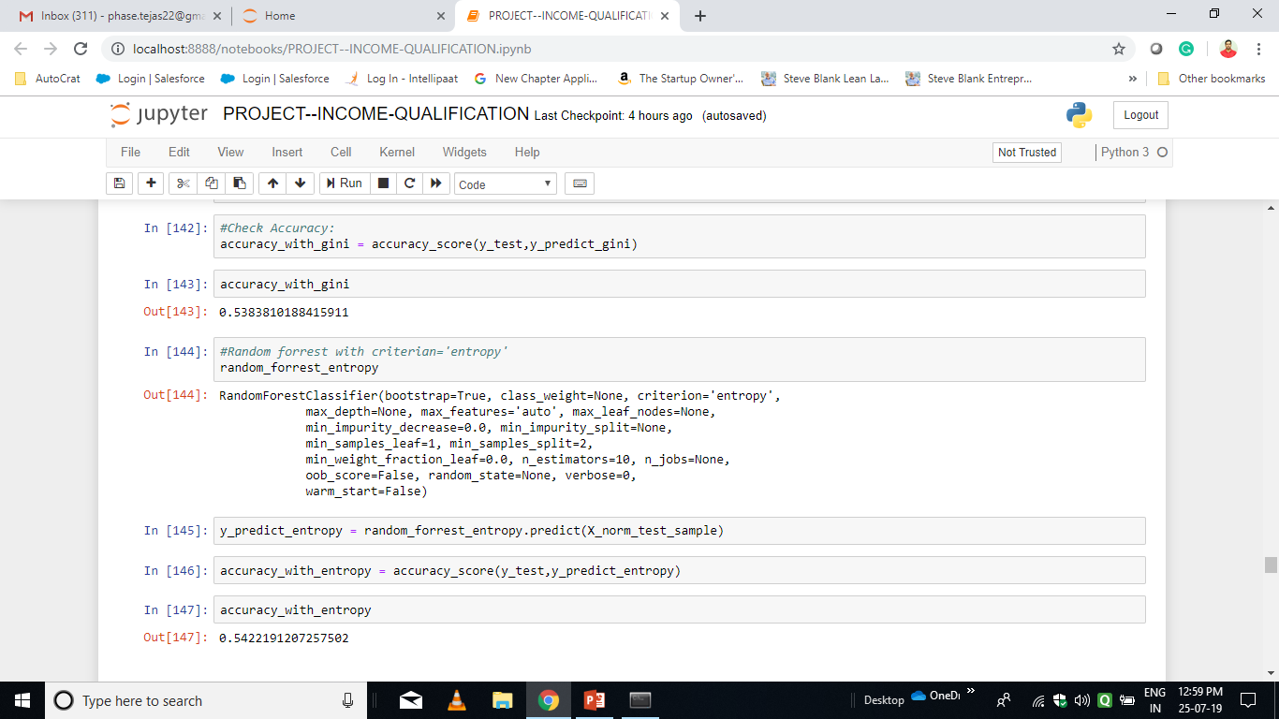
Check Accuracy using both the Criterion:

Slide 23
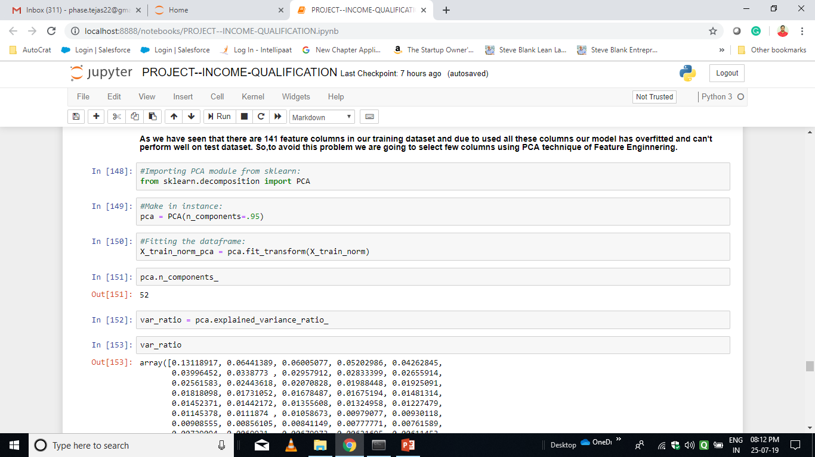
FEATURE ENGINNERING(PCA):

Slide 24
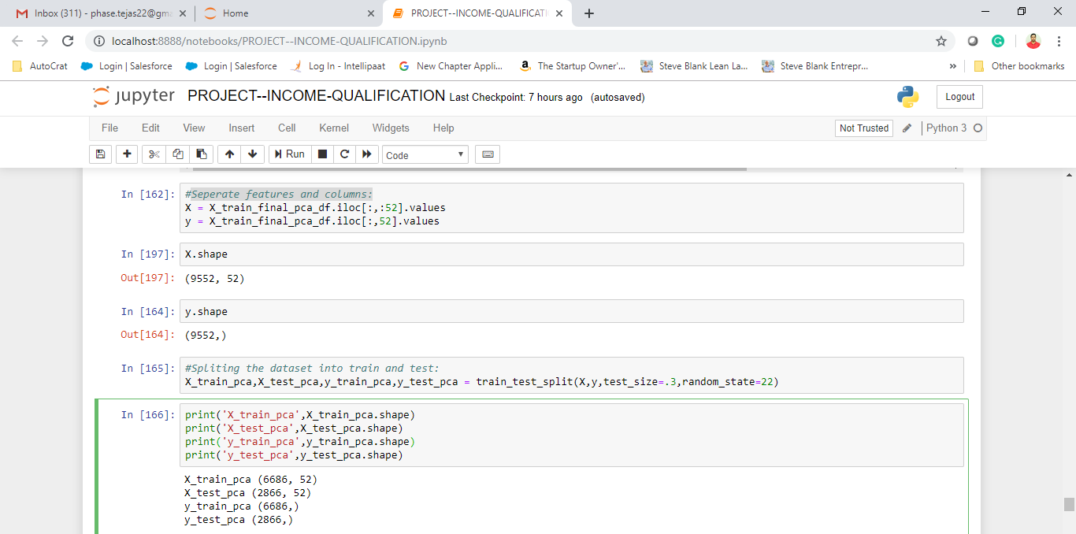
Separate features and columns:

Slide 25
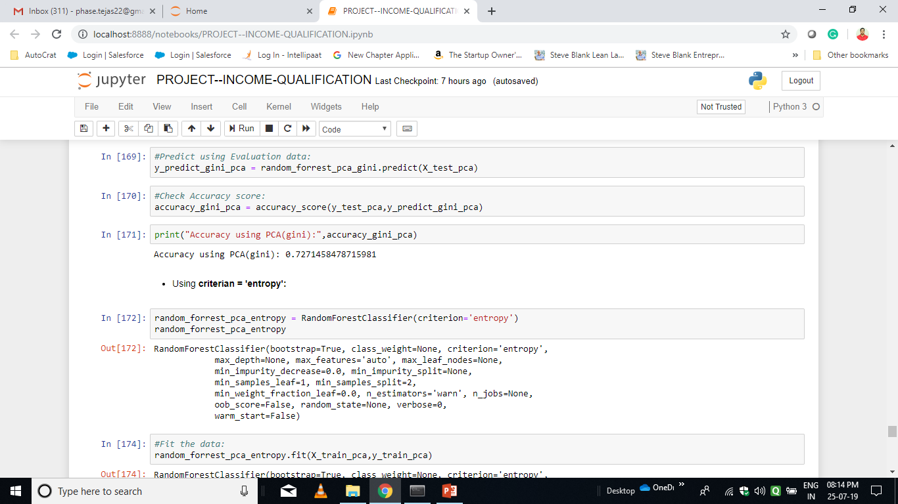
Evaluate the model:

Slide 26
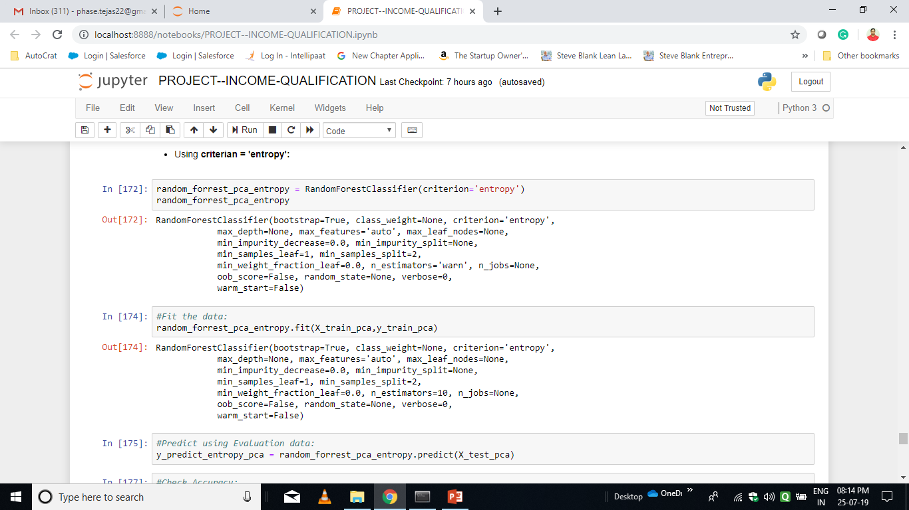
Using criterion=entropy:

Slide 27
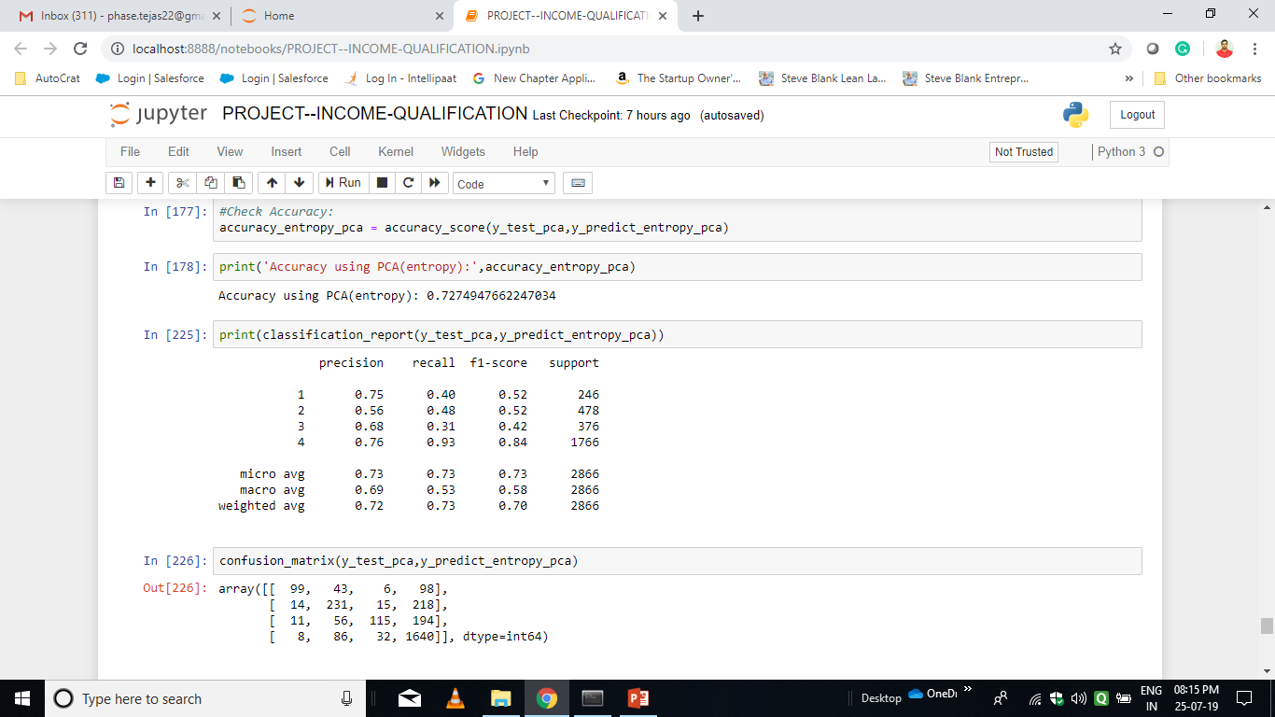
Check Accuracy:

Slide 28
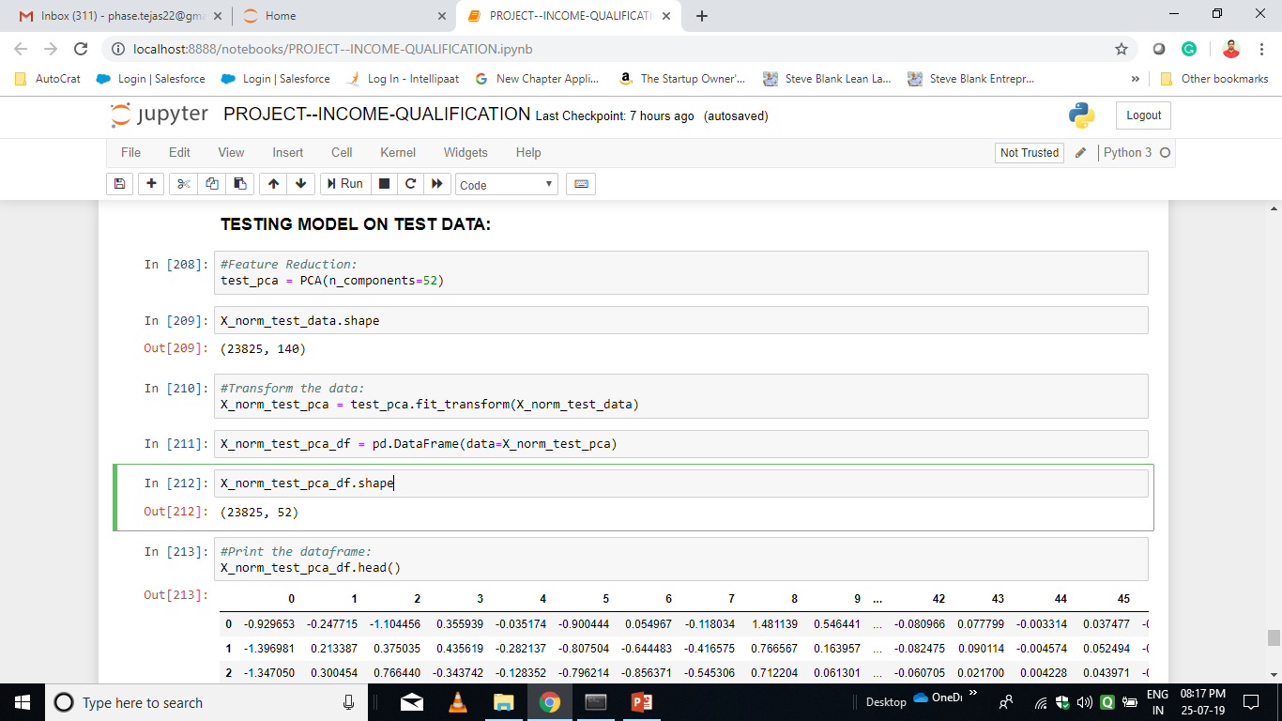
TESTING MODEL ON TEST DATA:¶ (PCA on TEST DATASET)

Slide 29
THANK YOU…!

